Slide 1
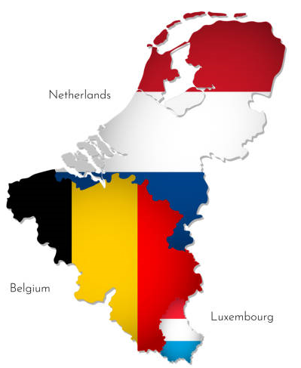
What do you know about the Low Countries?

Slide 2
How this will work
Why these countries?
I’m no expert, so be kind...
Clichés and history
The good, the bad and the ugly
A few East Anglian links
A few names...
Fun time!

Slide 3
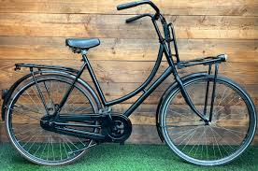
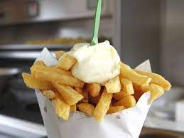
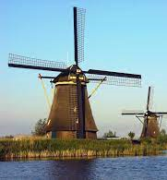
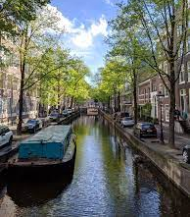
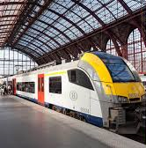
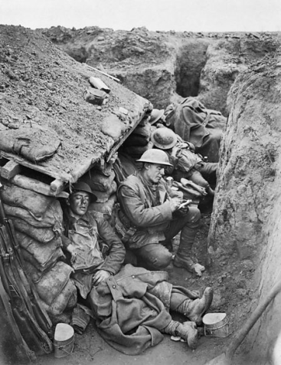
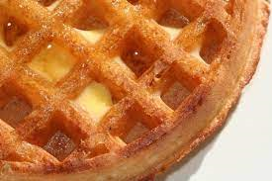
Think of a cliché?
Tulips
Bikes
Frites
Windmills
Chocolates
Canals
Public transport
Beer
WWI and WWII
Waffles
And ...

Slide 4
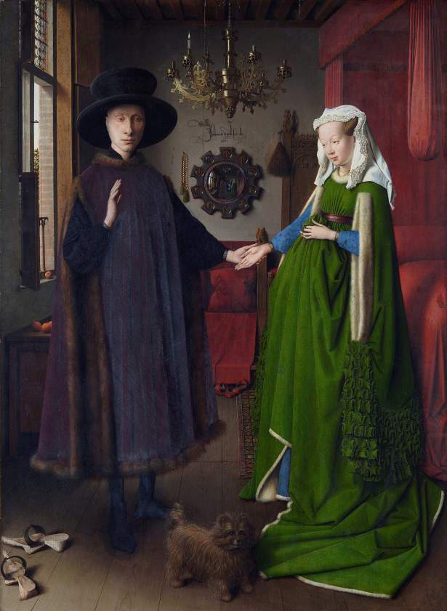
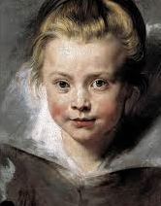
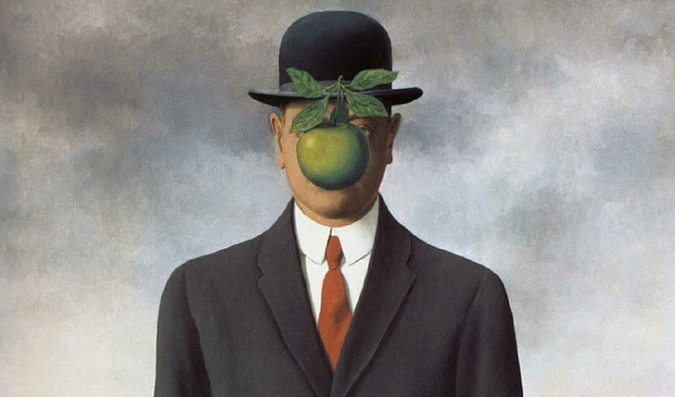
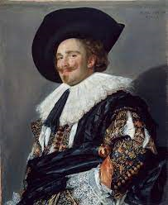
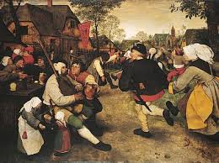
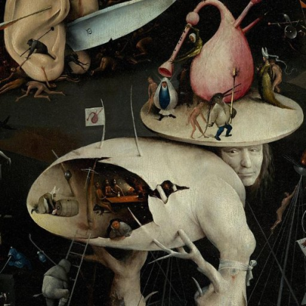
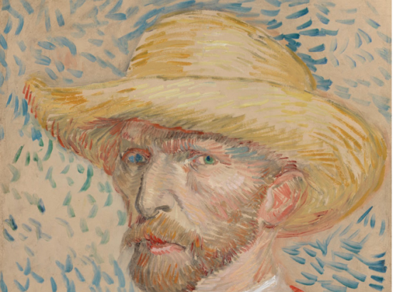
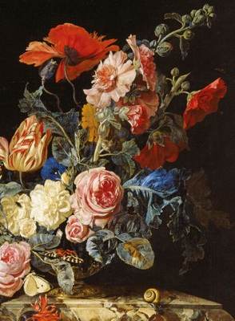
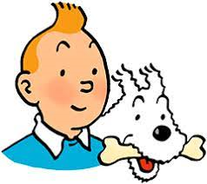
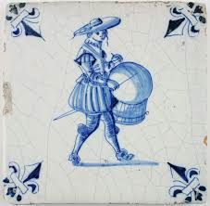
And ART!

Slide 5
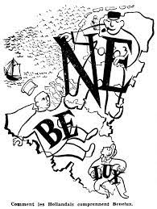
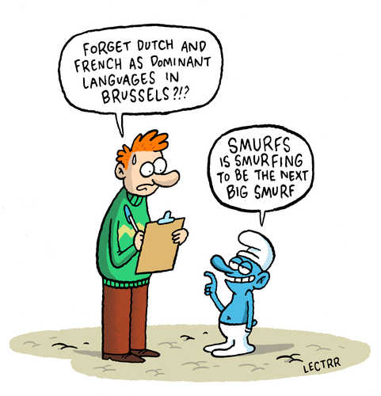
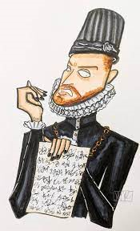
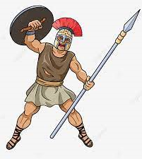
Whistle-stop history, etc lesson

Slide 6
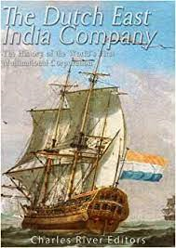
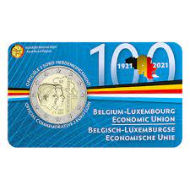
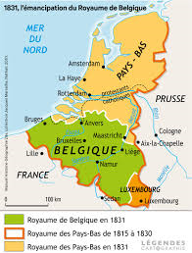
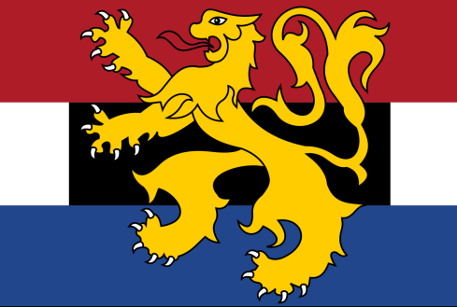
More history, etc

Slide 7
Tolerant and Egalitarian
Hanseatic league (11th C trading alliance) made cities large and wealthy: burghers were free, not vassels
Religious freedoms (to a point!)
Keeping the dikes in good repair
WWII experiences
If it doesn’t involve you personally, it’s none of your business; your success might benefit all.

Slide 8
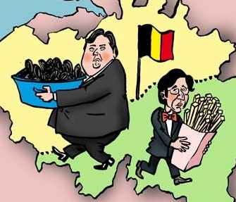
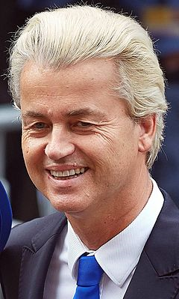
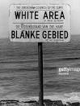
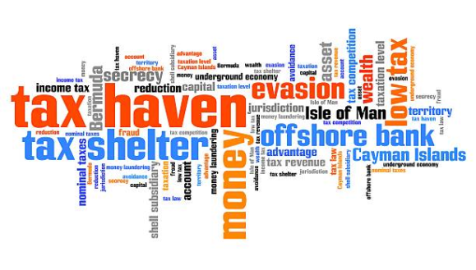
Lest we forget... The dark side
Colonial violence and slavery: Indonesia, Congo
Apartheid
Sectarian tensions: 2 languages; 2 cultures
Rise of the extreme Right
Child abuse/sex trafficking
Financial crime: tax havens & money-laundering

Slide 9
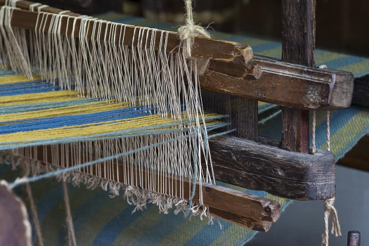
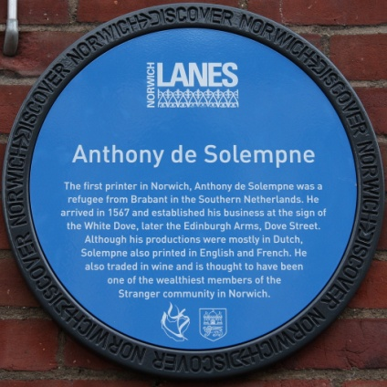
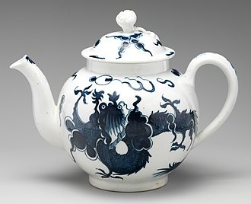
Benelux – East Anglia connections
Immigration:
Mercenaries; Escaping floods
Invitations to work:
Fabric and weaving
Engineering, Print
War
Porcelain exports
Canaries

Slide 10
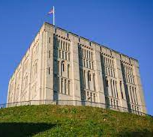
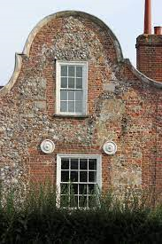
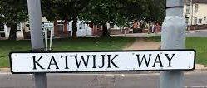
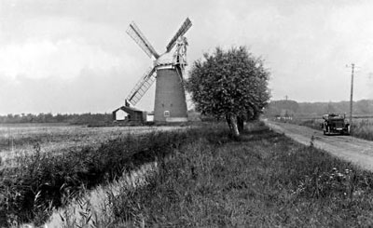
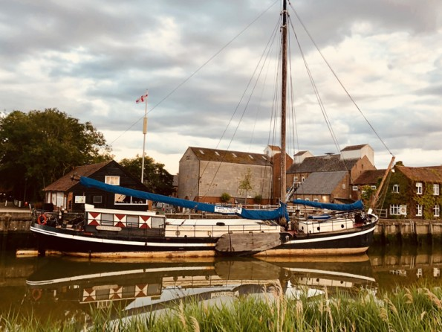
Wander round
Museums
Place names
Architecture (gable ends)
Words:
buoy, cruise, brandy, easel, sketch, offal, slurp, foisty, fye, Norwich’s “plains” = pleins
Wind turbines on the marshes
Boats visiting East Coast harbours

Slide 11
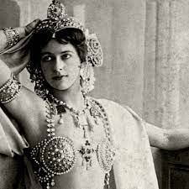
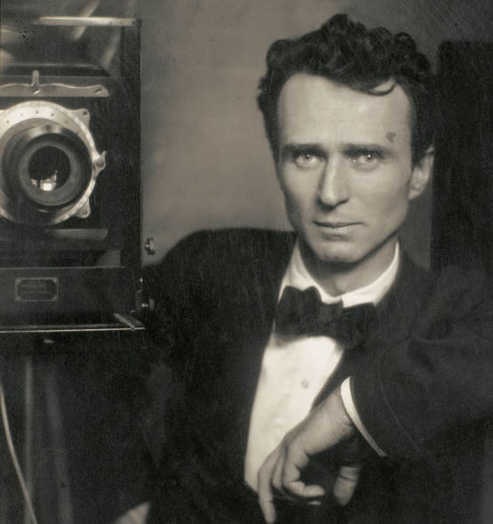
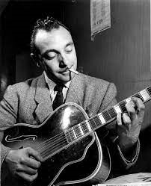
Benelux celebs
Mata Hari Eduard J Steichen Django Reinhardt

Slide 12
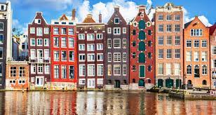
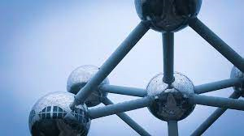
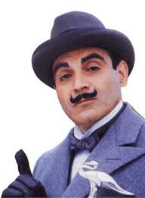
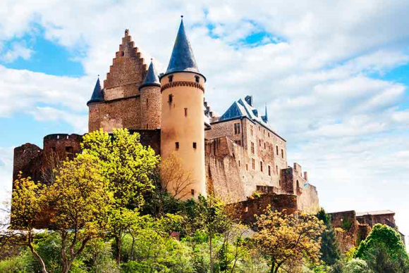
And now for some fun

Slide 13
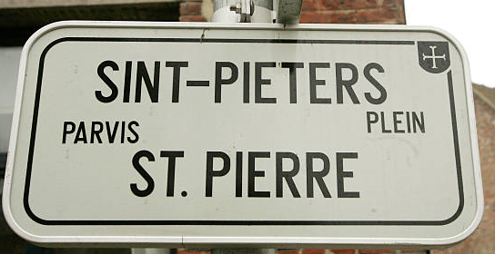
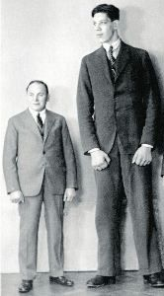
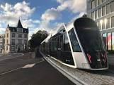
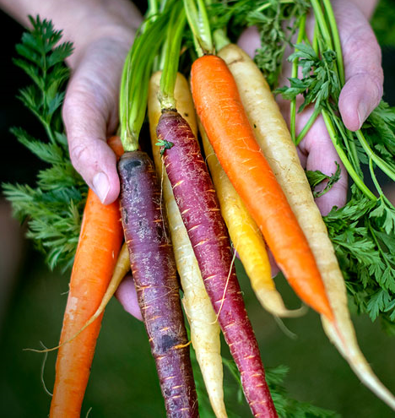
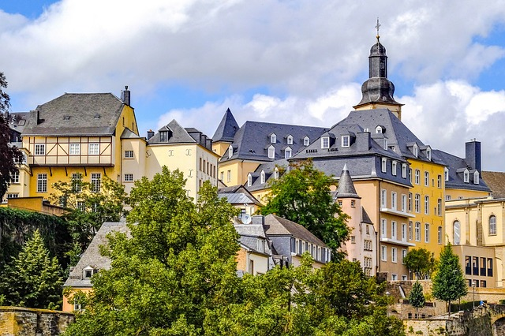
The answers

Slide 14
The final answer...?

Slide 15
Other cultural “highlights”?

Slide 16
Thank you!
Dank u
Bedankt
Merci
Dank je
Villmools Merci

