Slide 1


Welcome – we are NWR Sonning Common
Please enjoy our 50th Celebration!

Slide 2

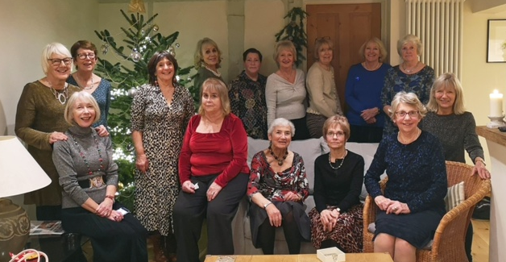
NWR Sonning Common
1976 - 2026

Slide 3
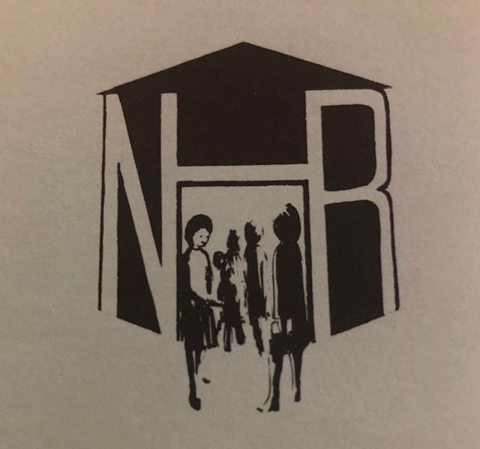
Early beginnings –
National Housewives’ Register
The Group was formed in May 1976
FIRST Local organiser was local resident Pam Gibbon
First meeting took place on 24th June 1976
The theme was Places we have Lived

Slide 4
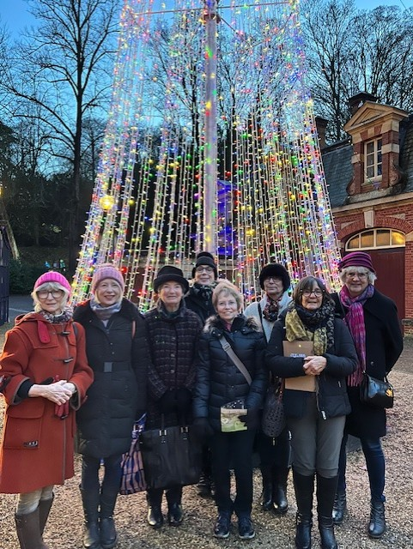
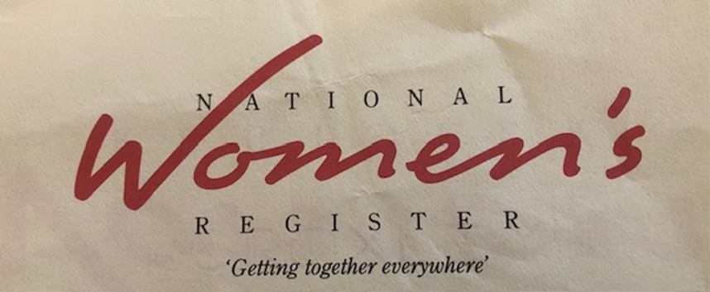
What NWR is about:
‘We encourage the formation of groups who wish to participate in stimulating wide-ranging discussion, creating an opportunity for friendship and other activities’

Slide 5

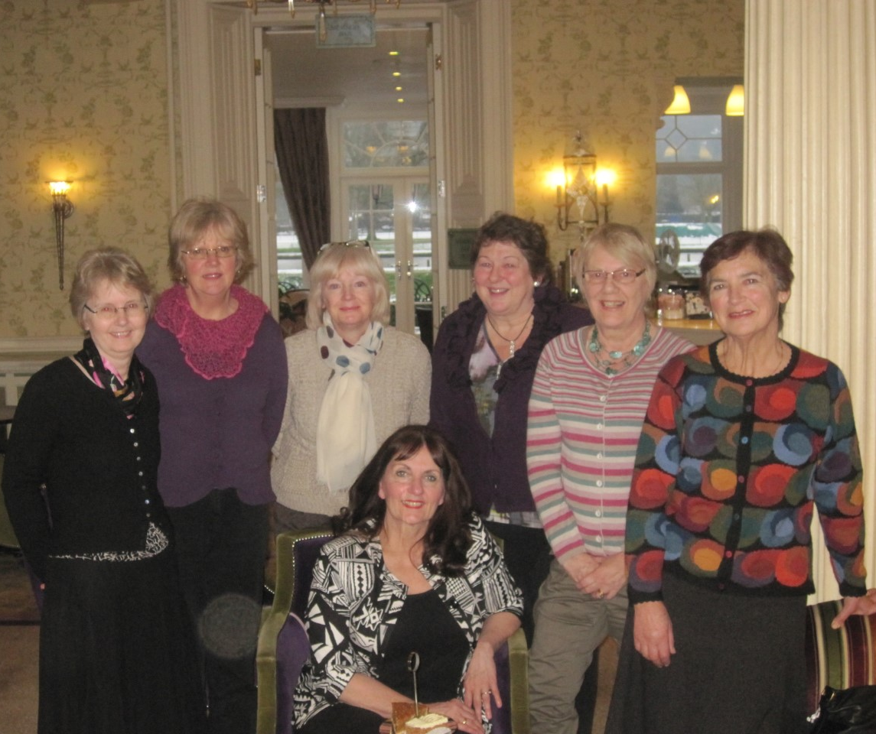
‘For friendship, discussion, education and self-development’

Slide 6
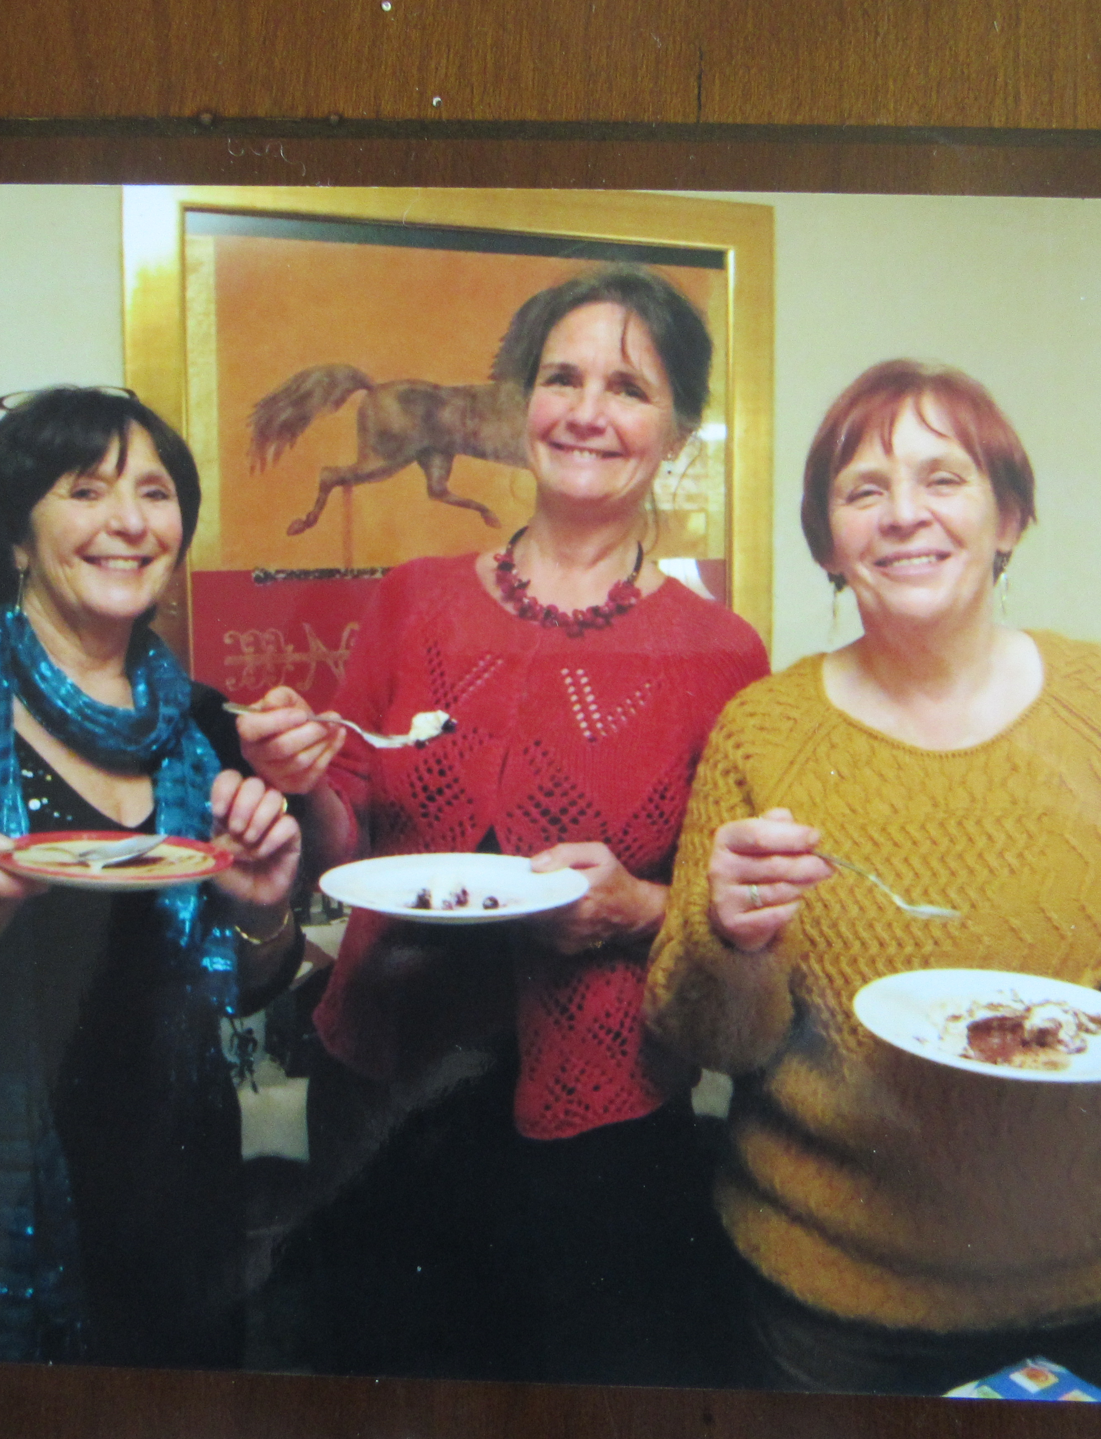

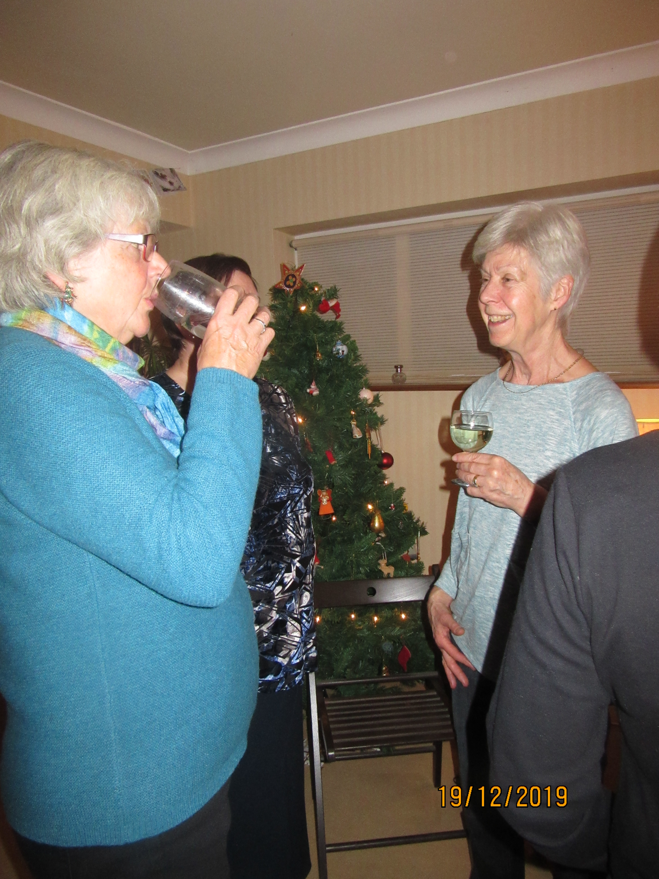
‘To laugh and have fun at meetings with light hearted discussion topics’

Slide 7

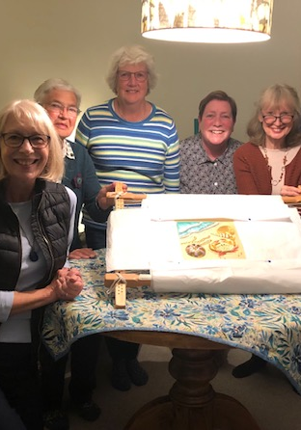
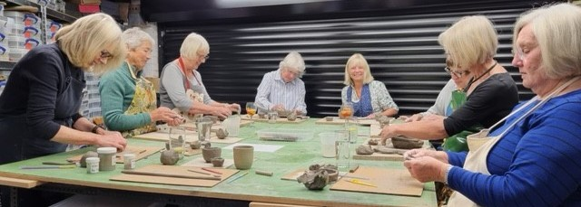
‘Start a new hobby – join a sub-group and connect with women with similar interests.’

Slide 8
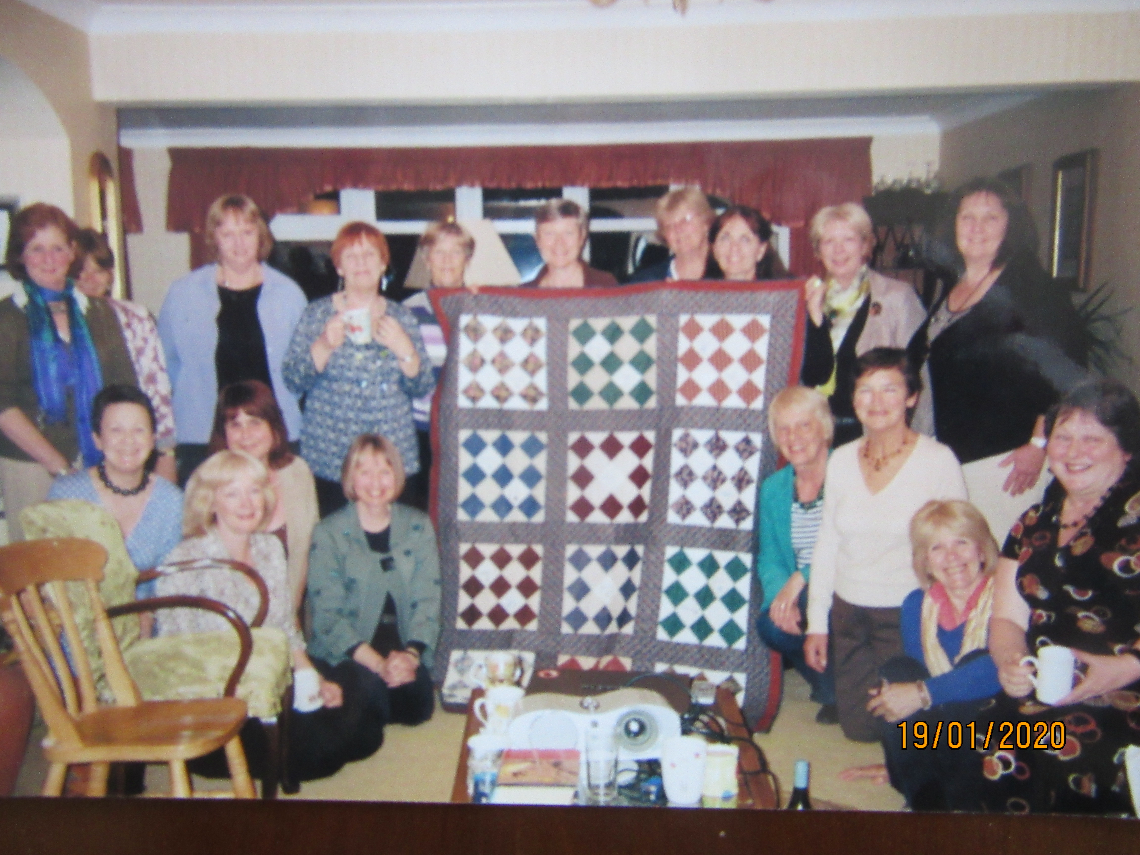
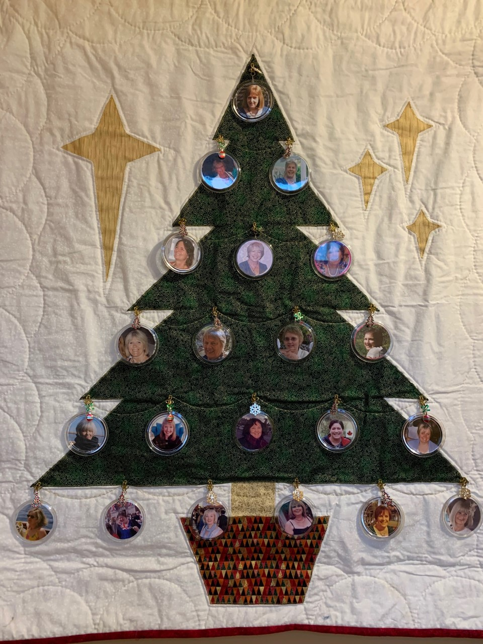
Including making special farewell gifts together for old friends.

Slide 9
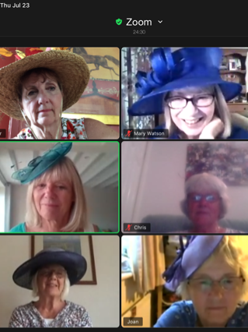
‘Hold virtual meetings’
Our Ascot Day Zoom during Covid, 2020

Slide 10
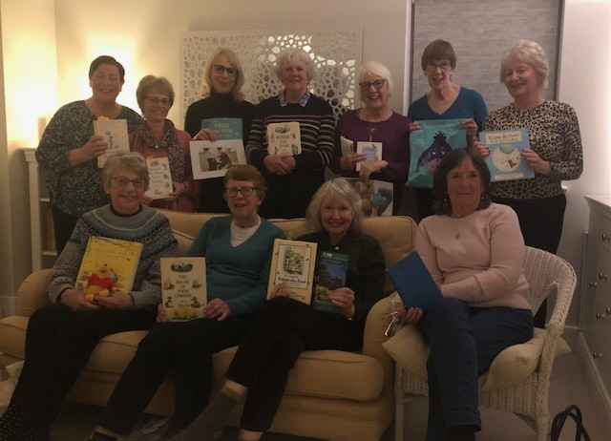
‘Learn something new from the comfort of our own homes’
Winnie the Pooh Night!

Slide 11
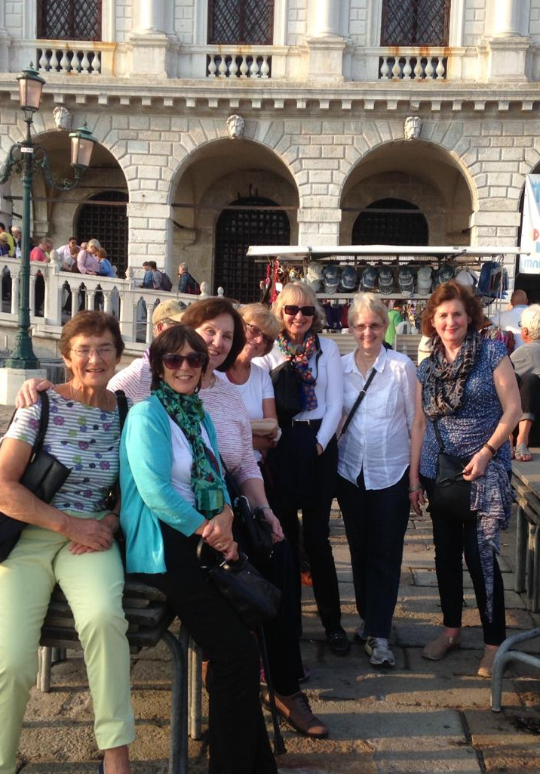
‘Join other members for trips and excursions’
NWR SC - 16 different countries over 13 years!
Watch our photo galleries….

Slide 12

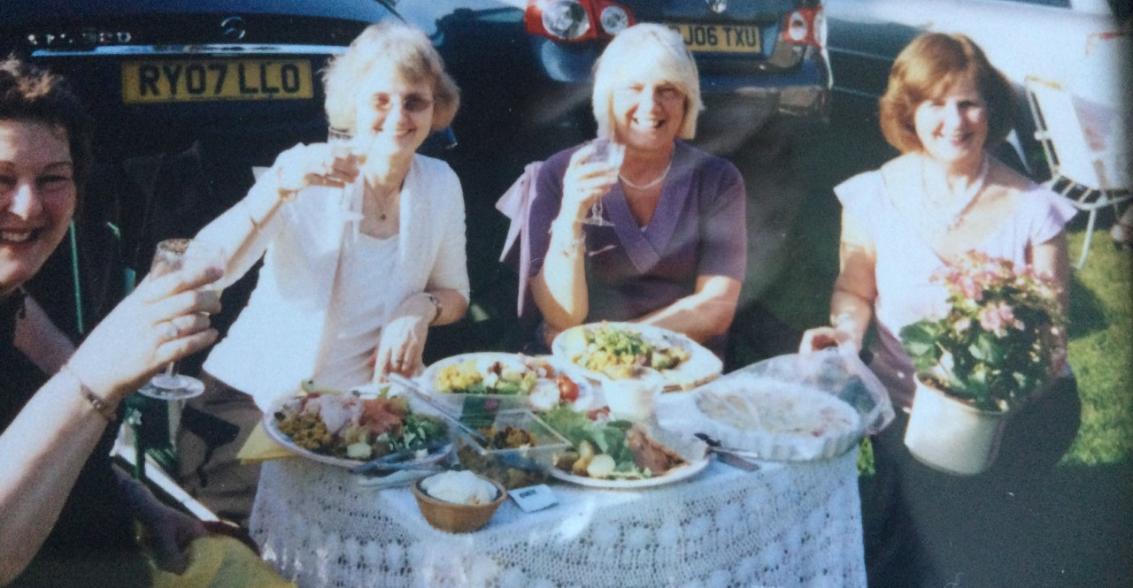
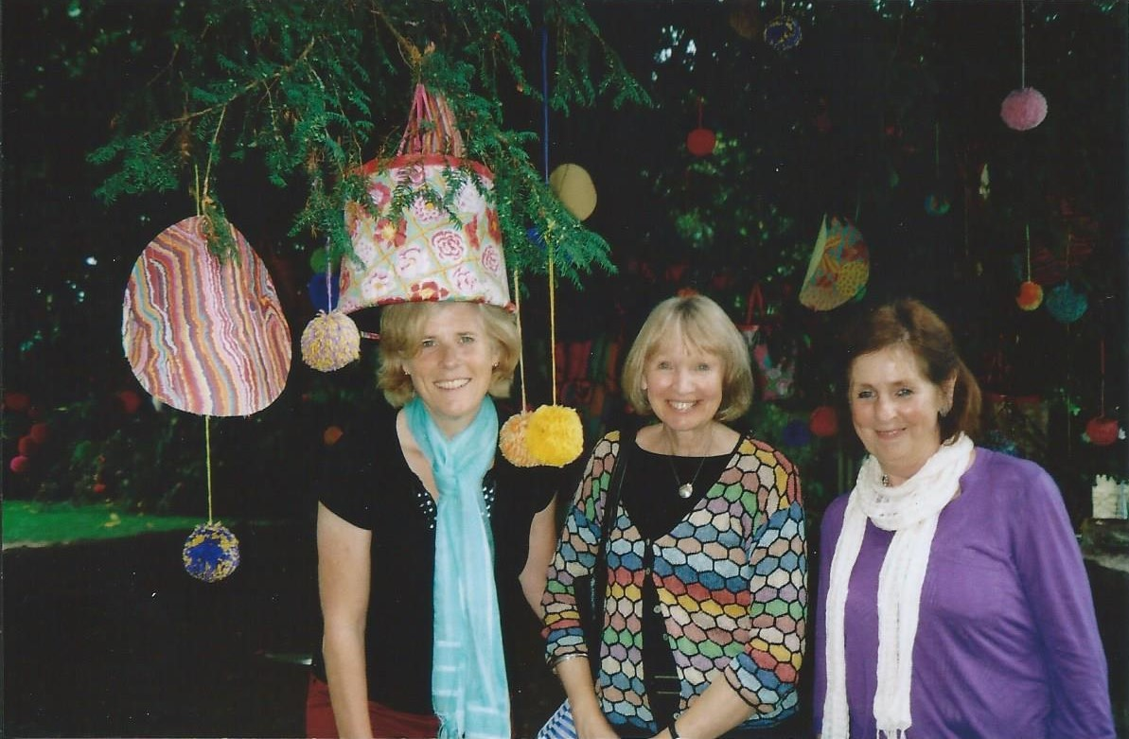
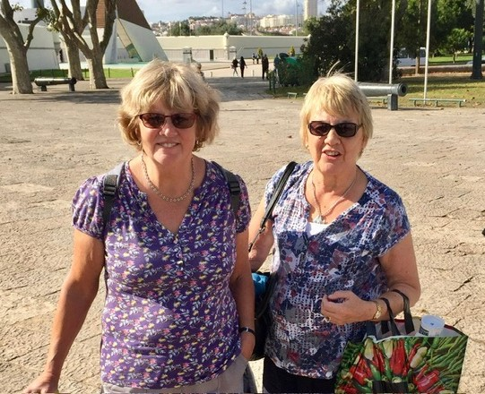
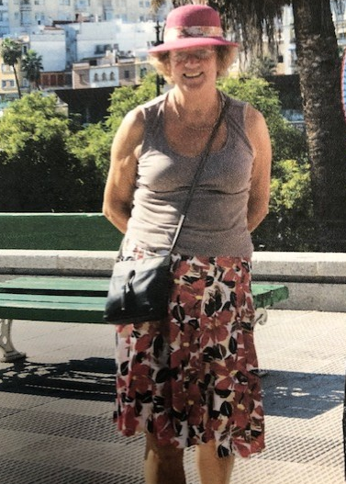
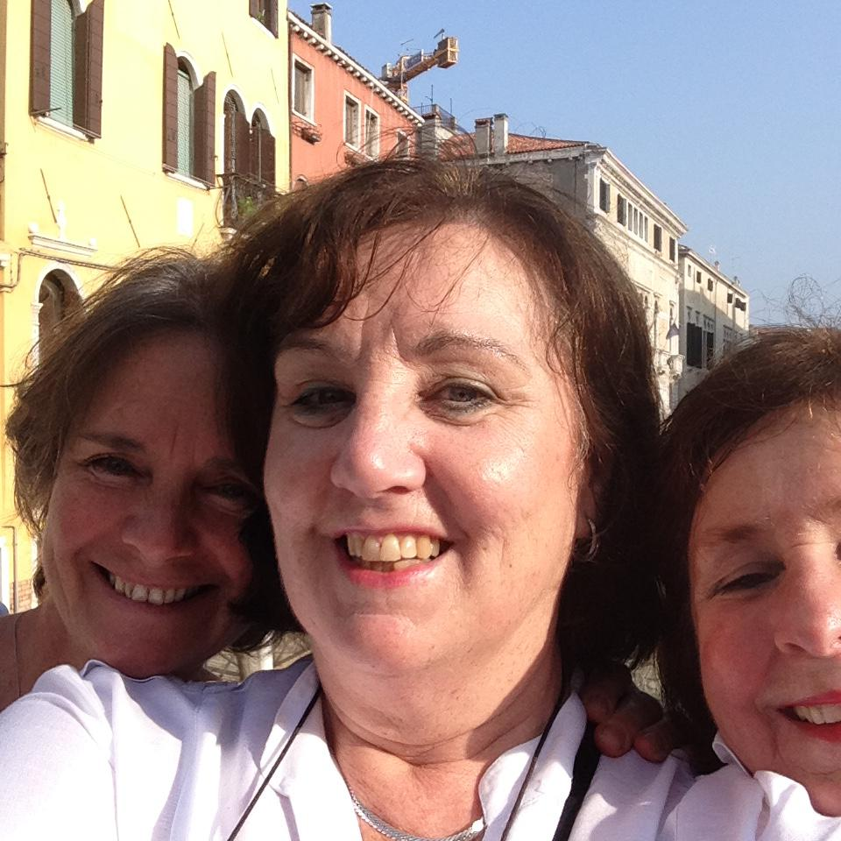
Our Travel Photo Gallery no. 1

Slide 13
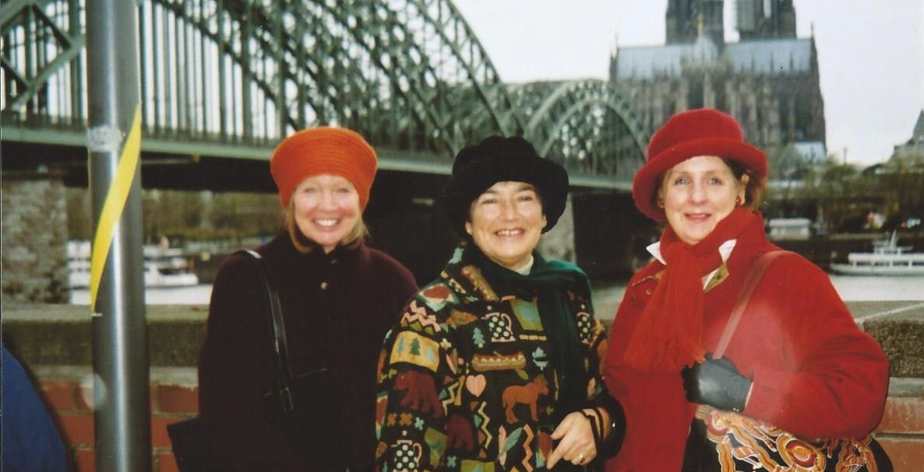
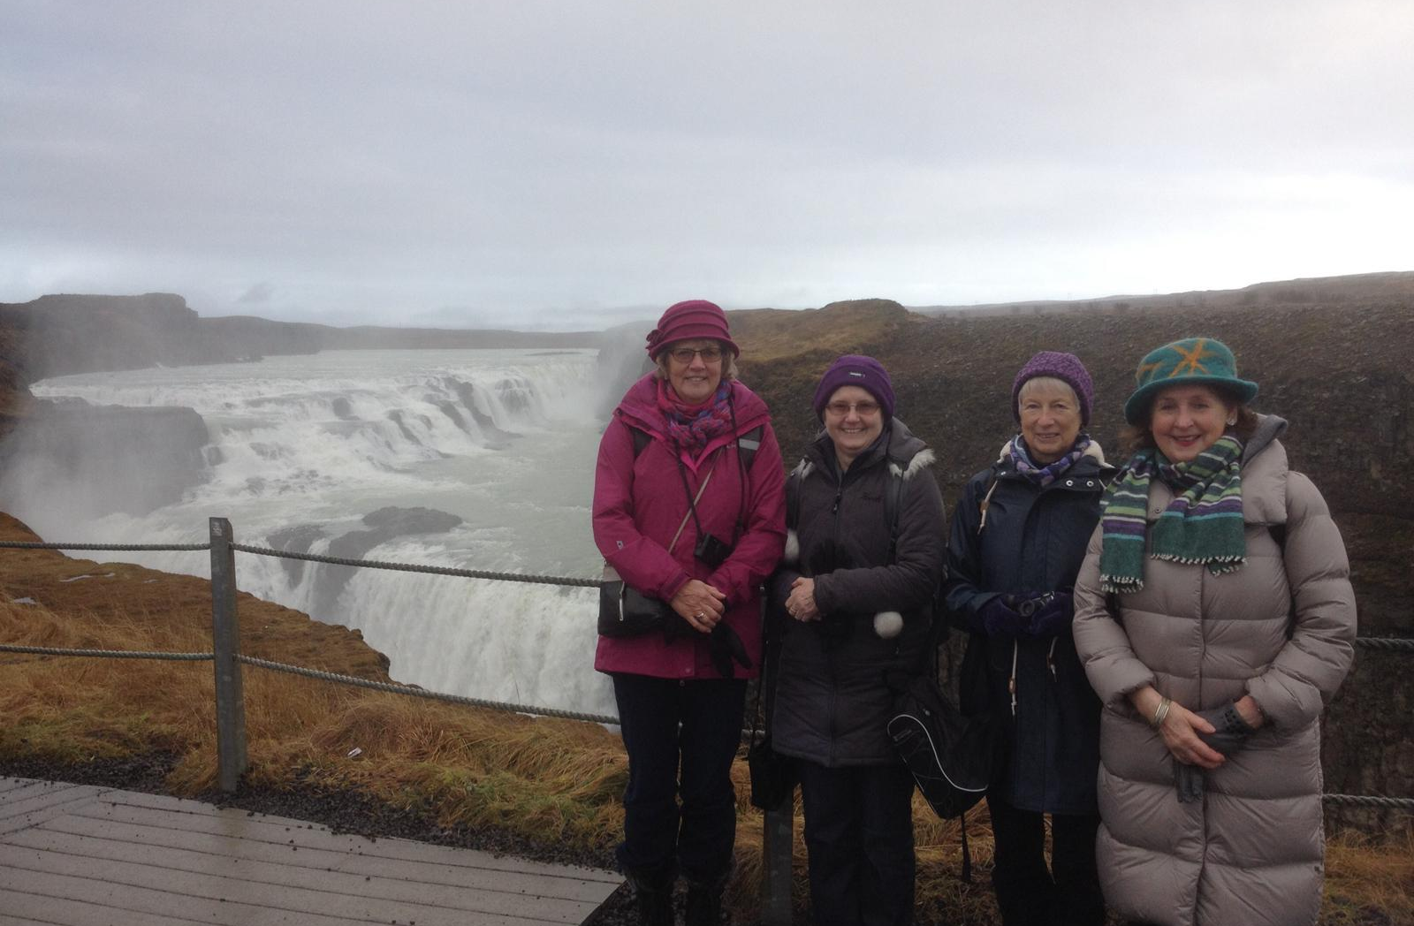
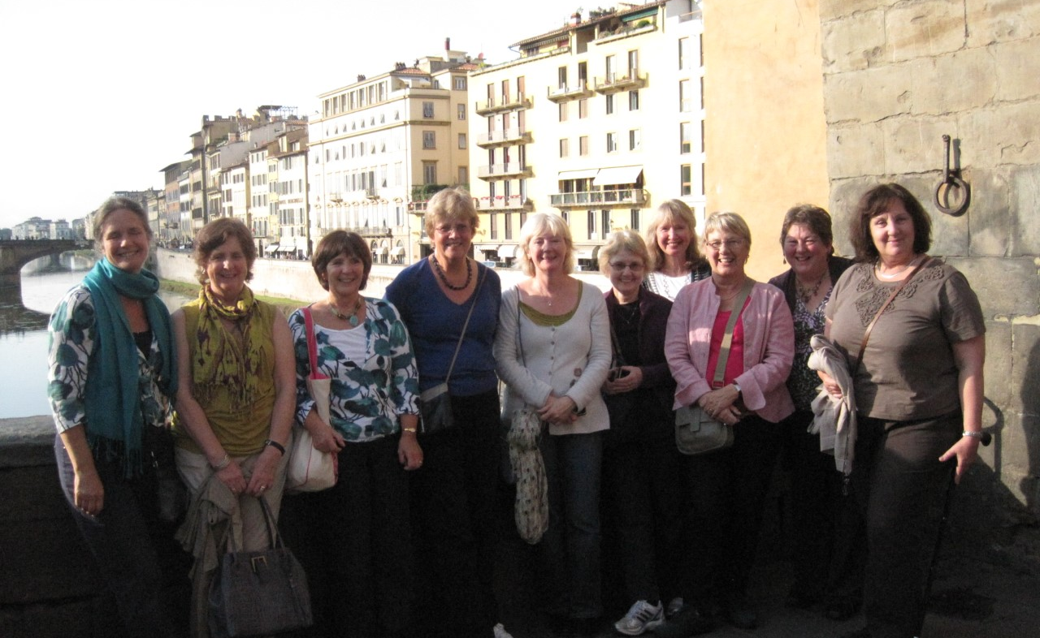
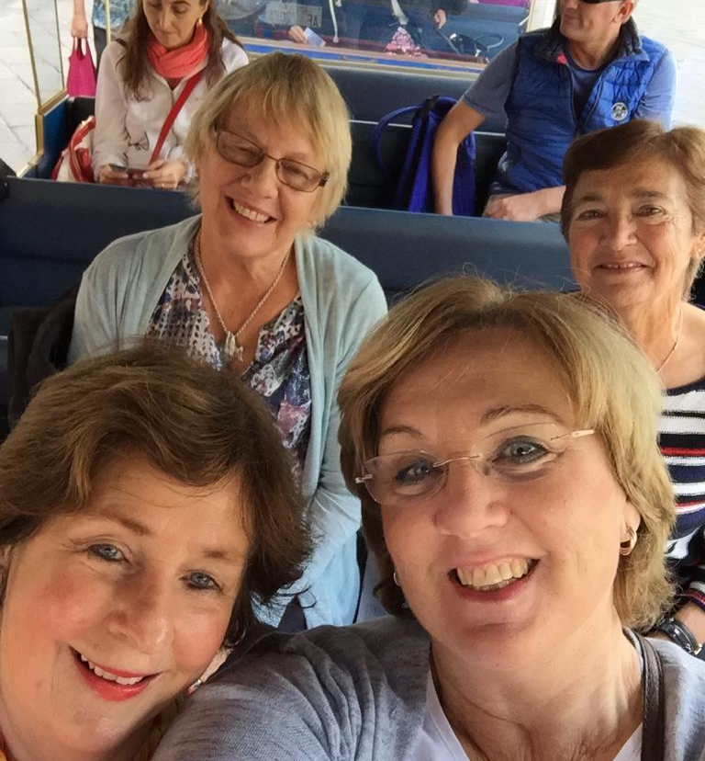
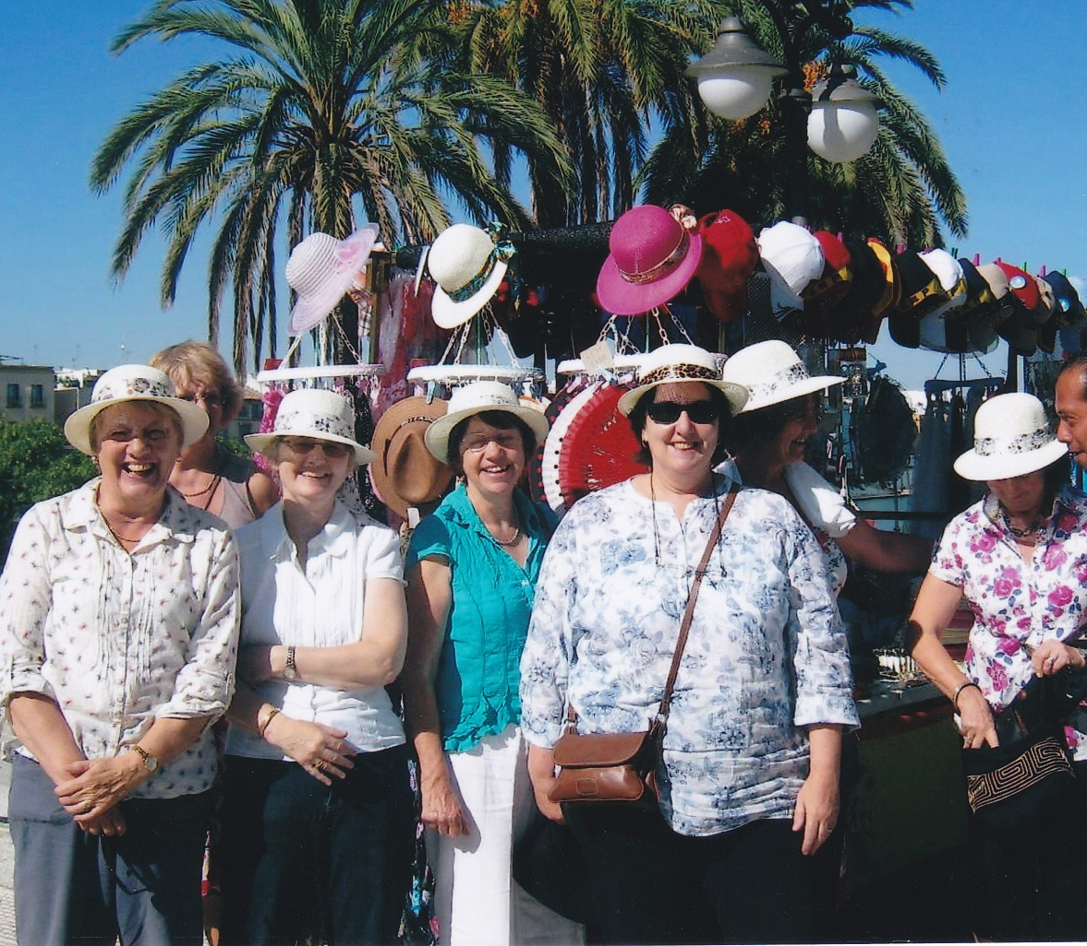
Travel Photo Gallery no. 2

Slide 14
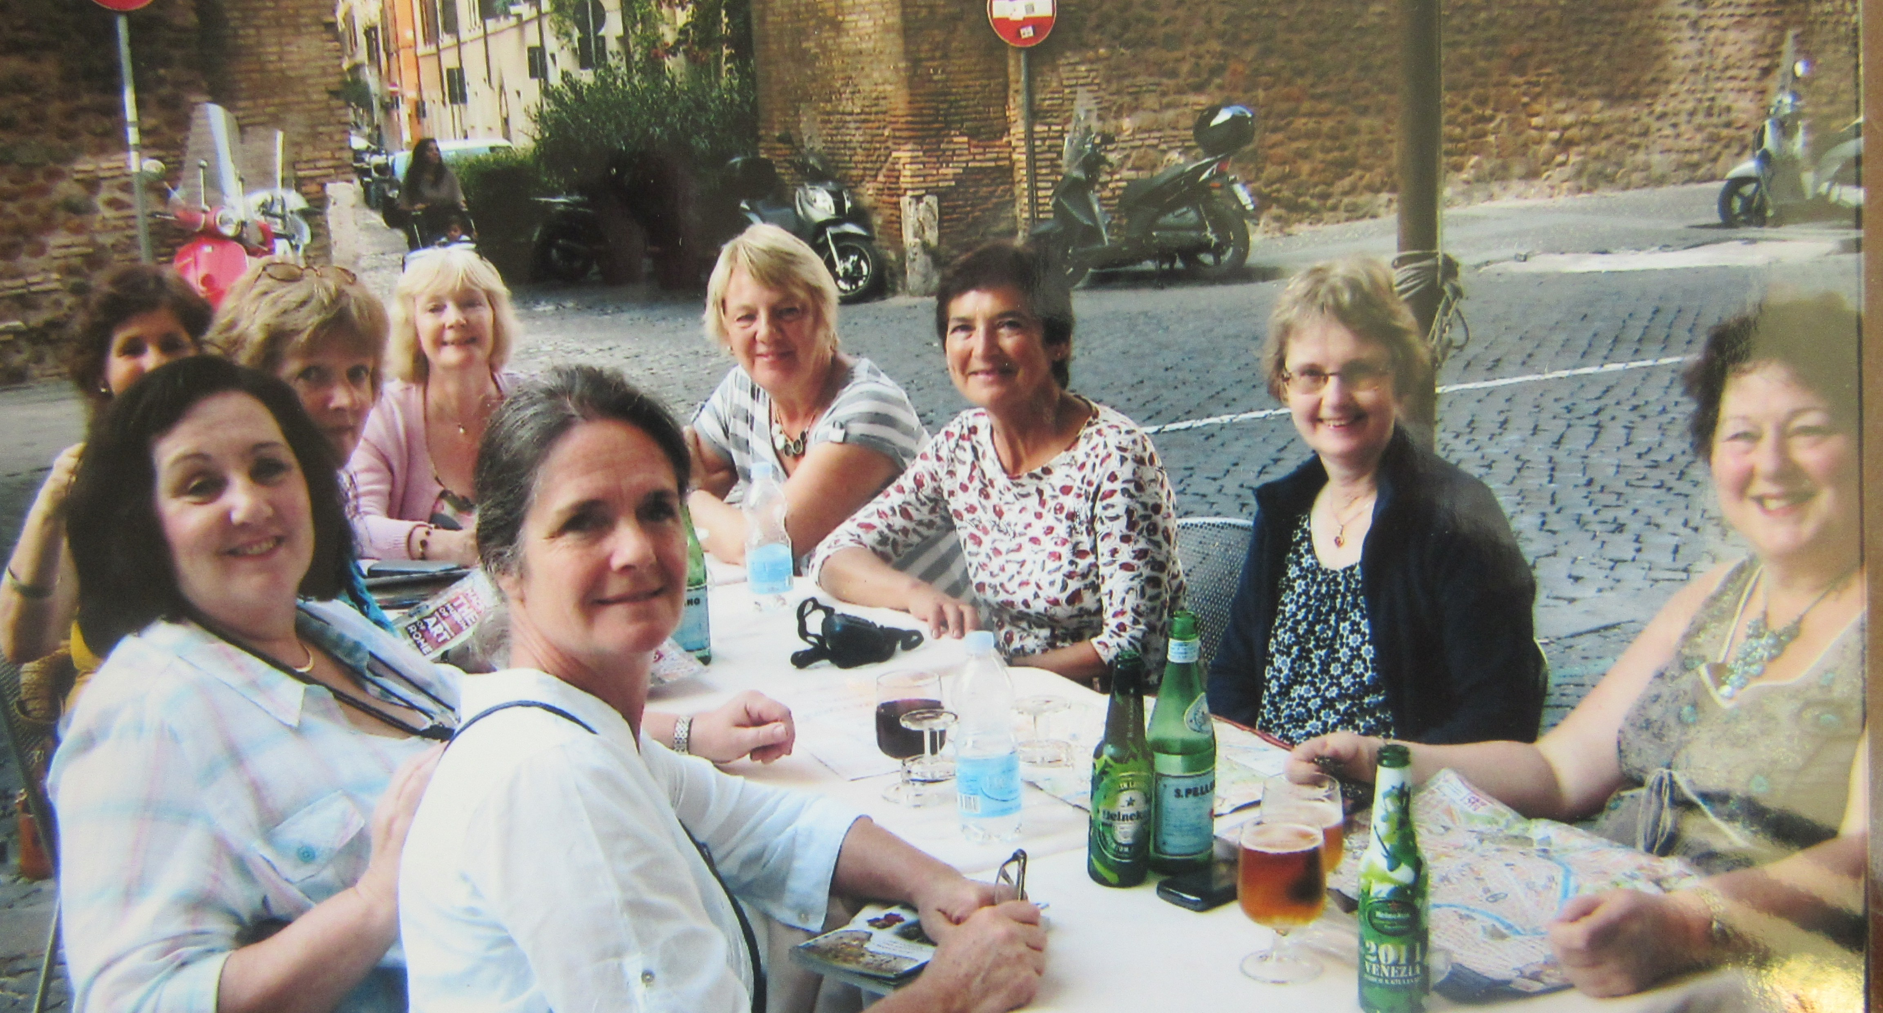
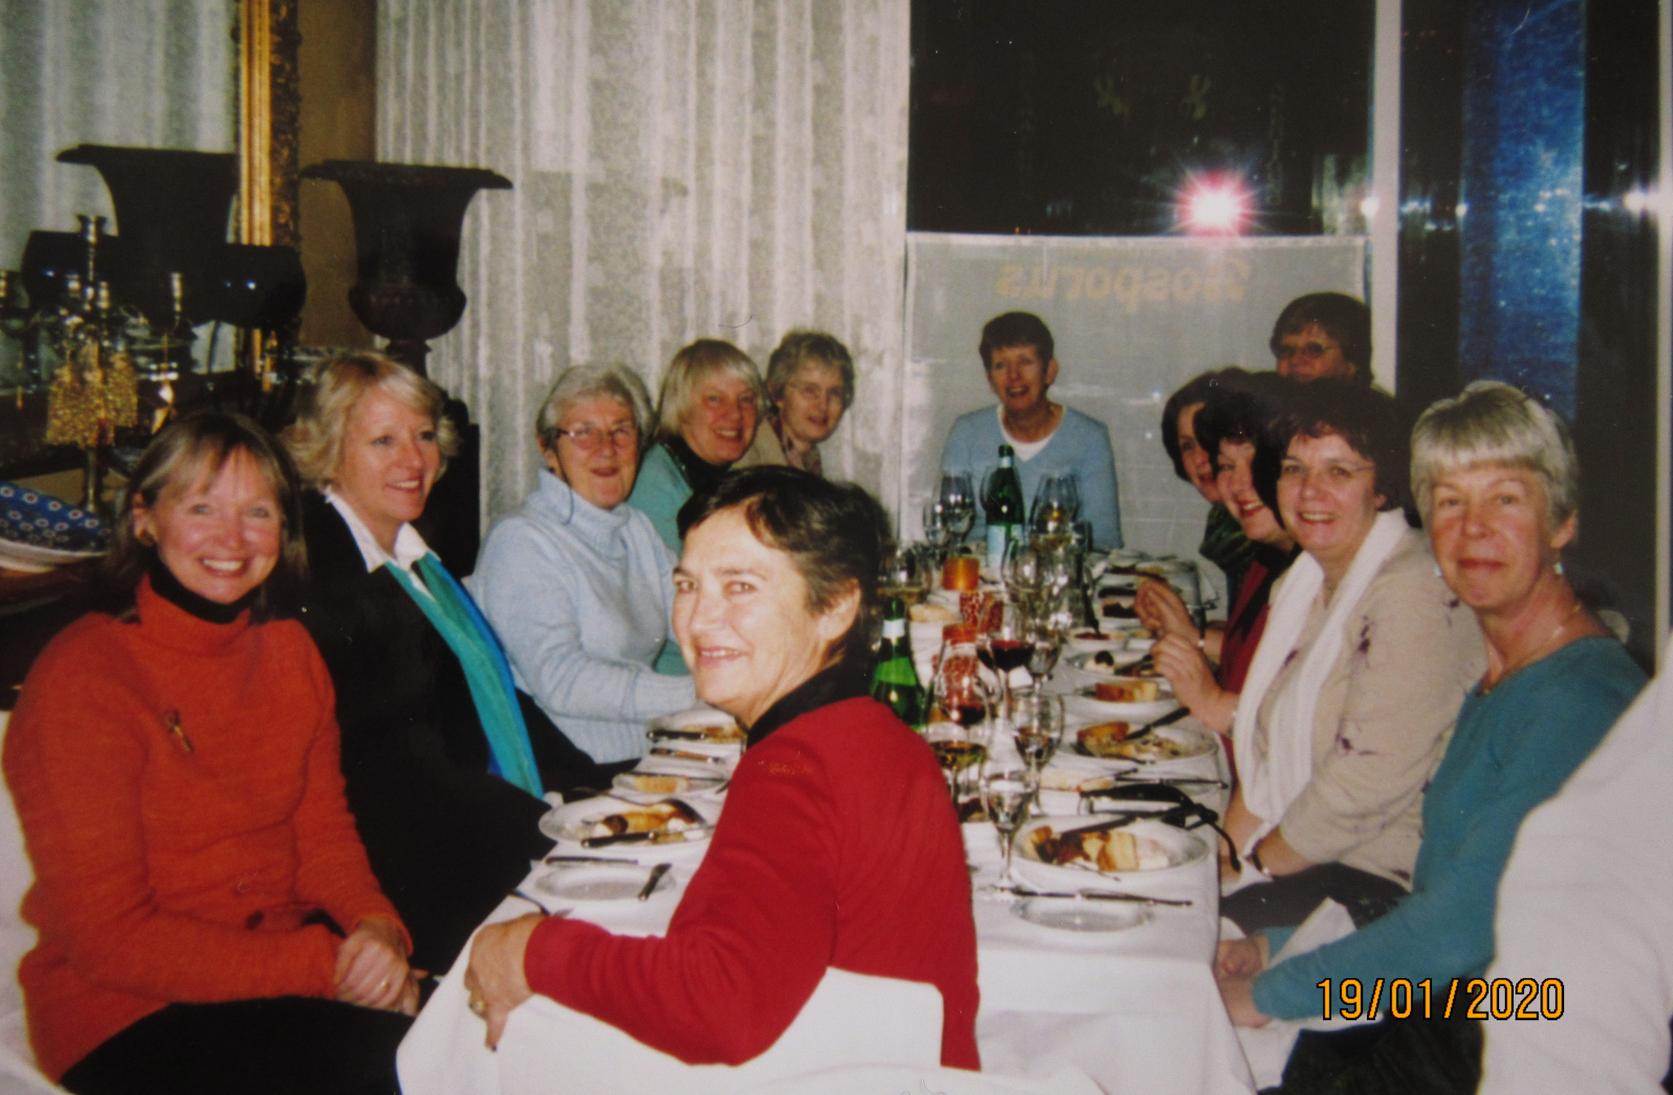
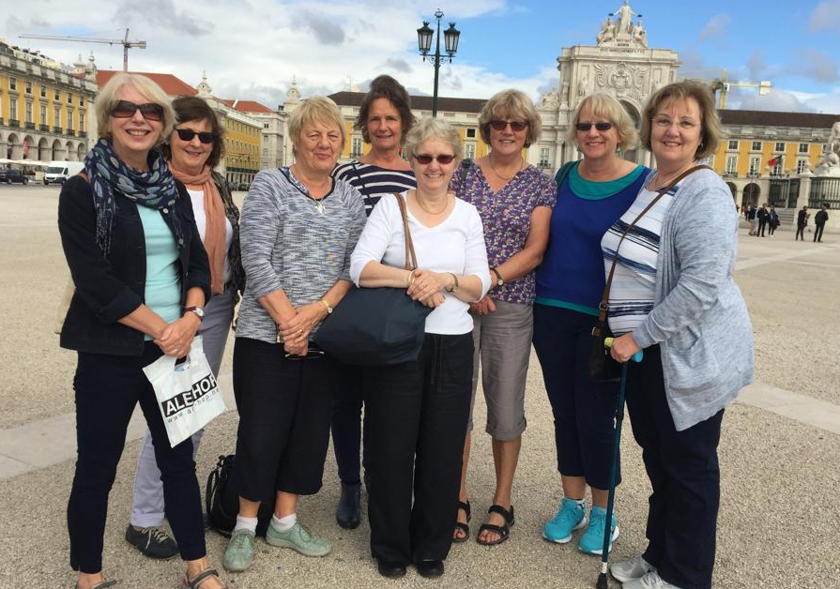
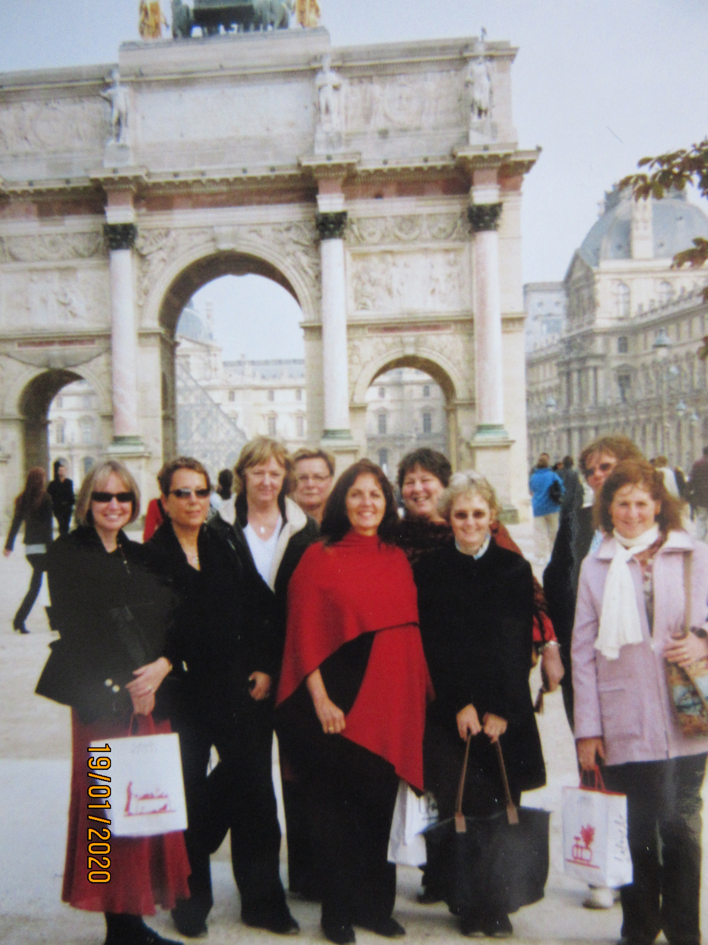
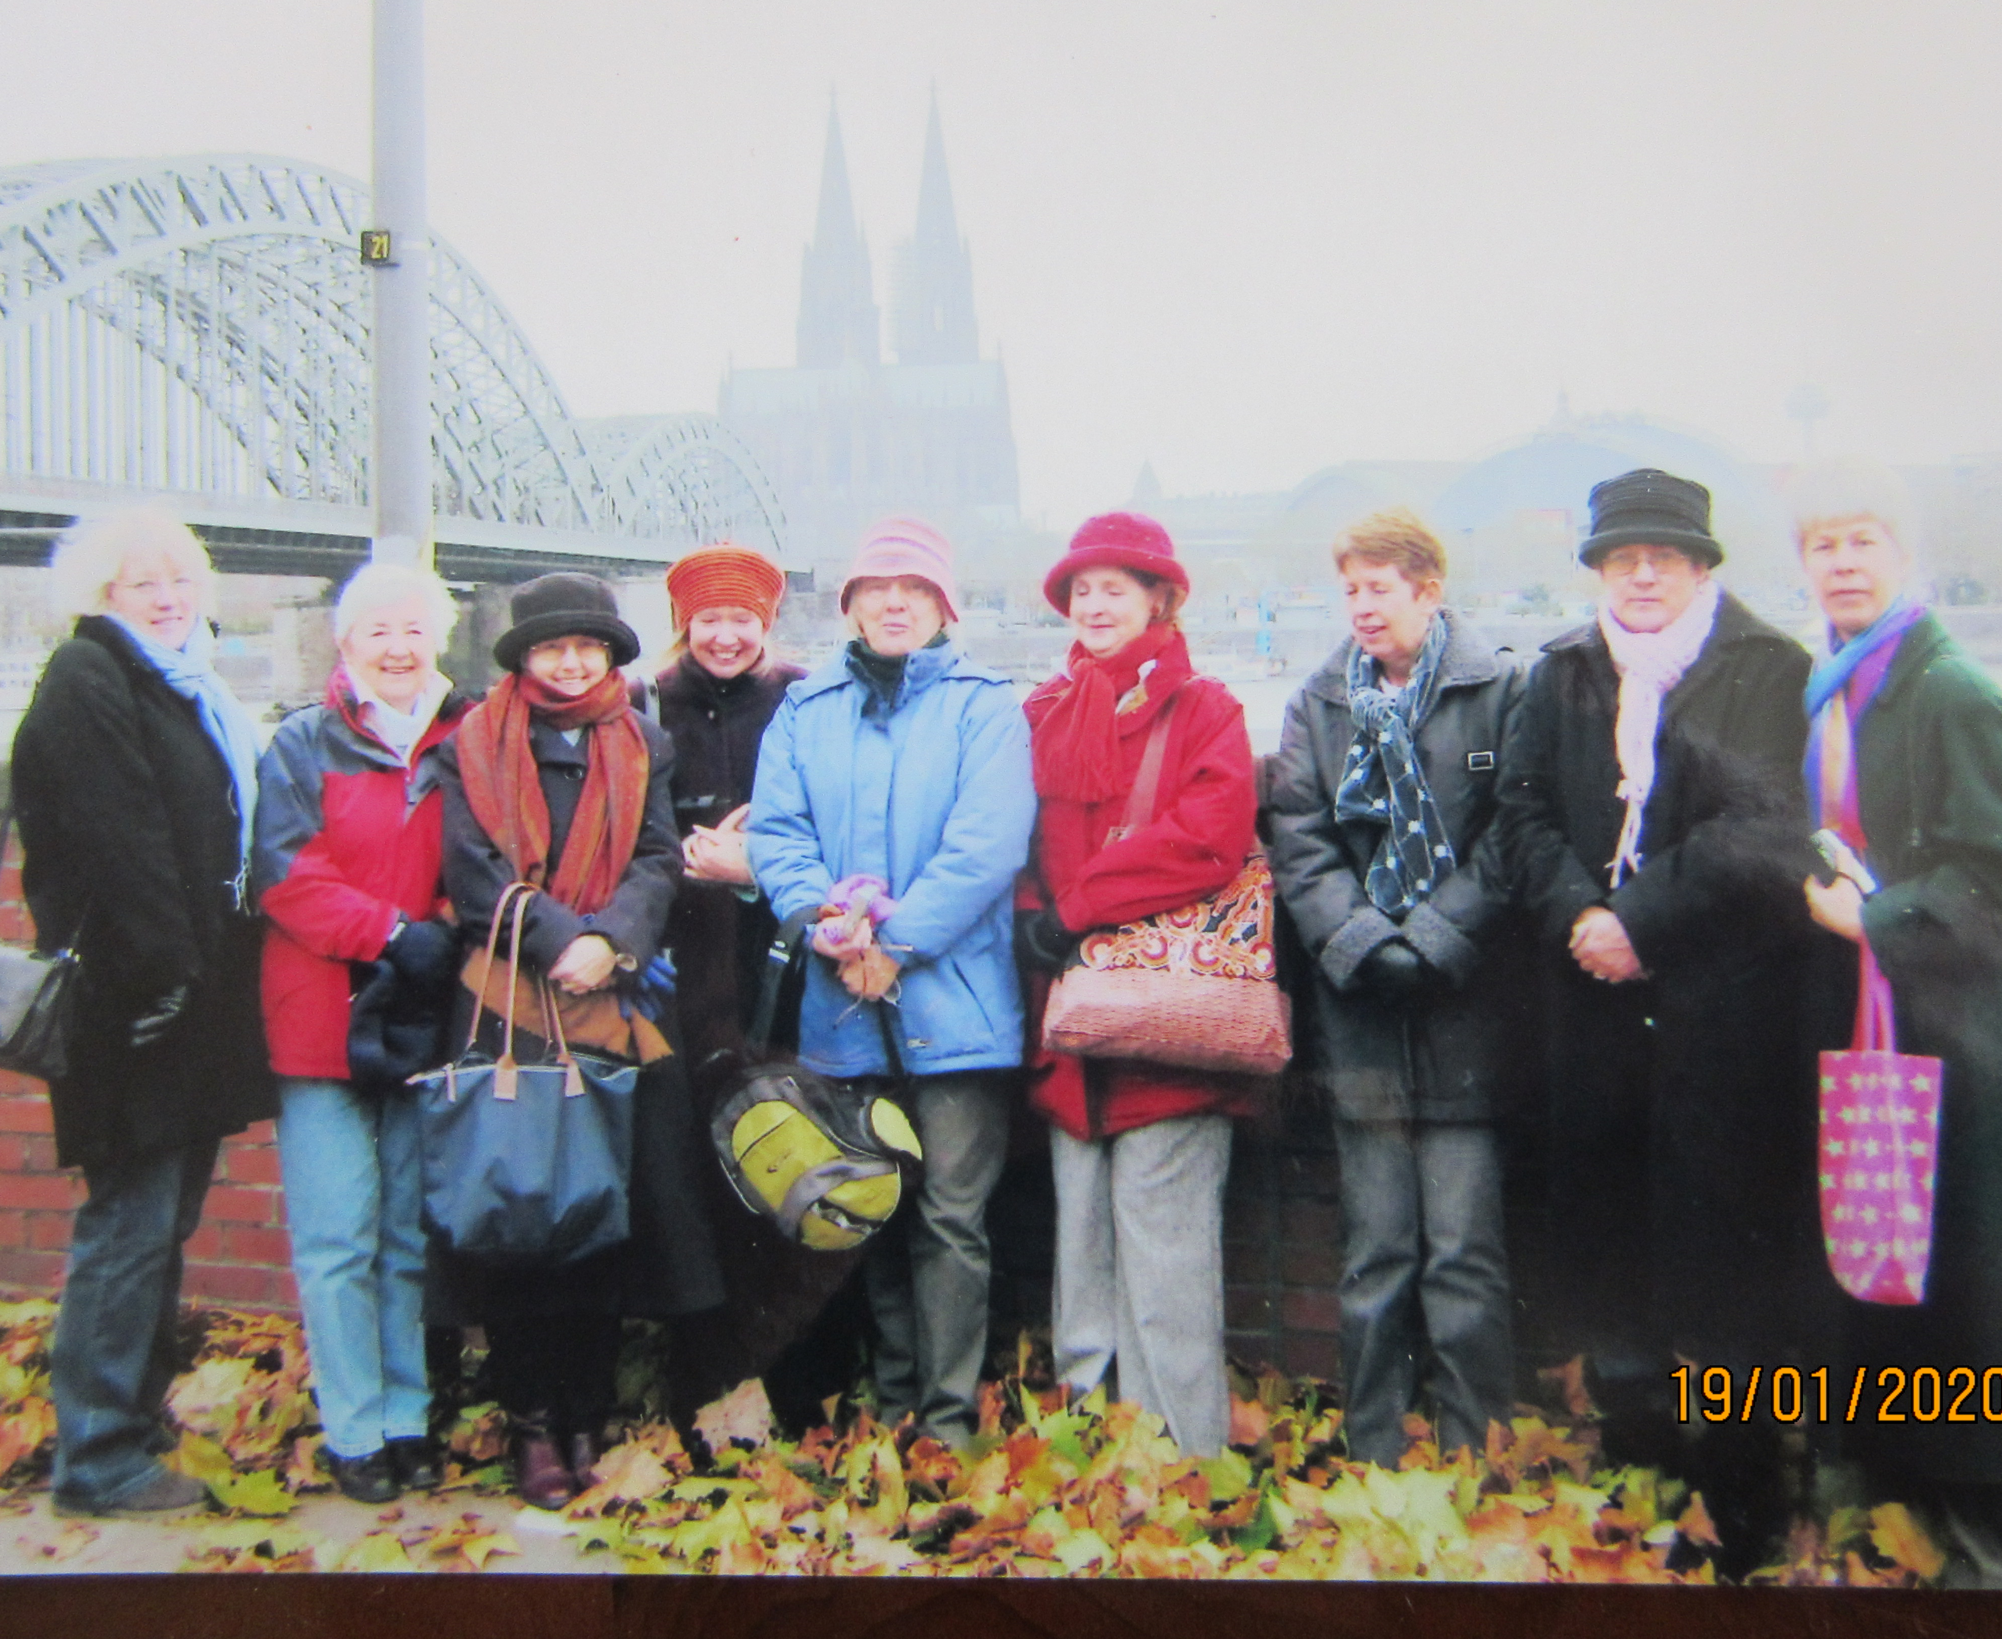
Travel Photo Gallery no. 3

Slide 15
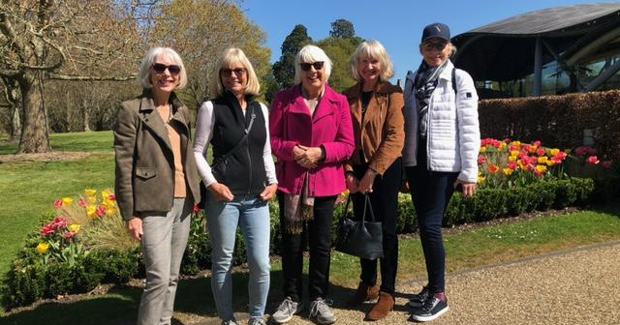

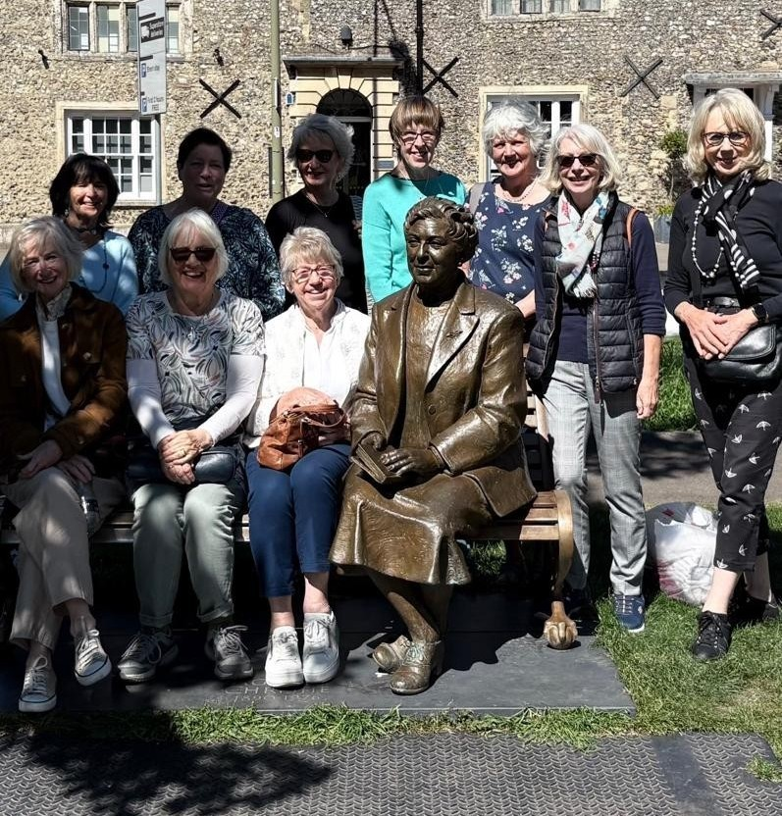
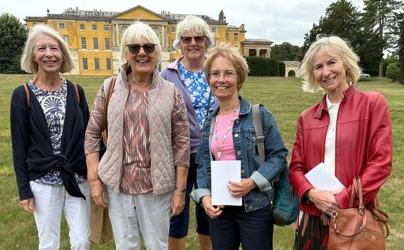
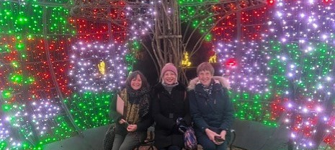
.
And we love our excursions…

Slide 16
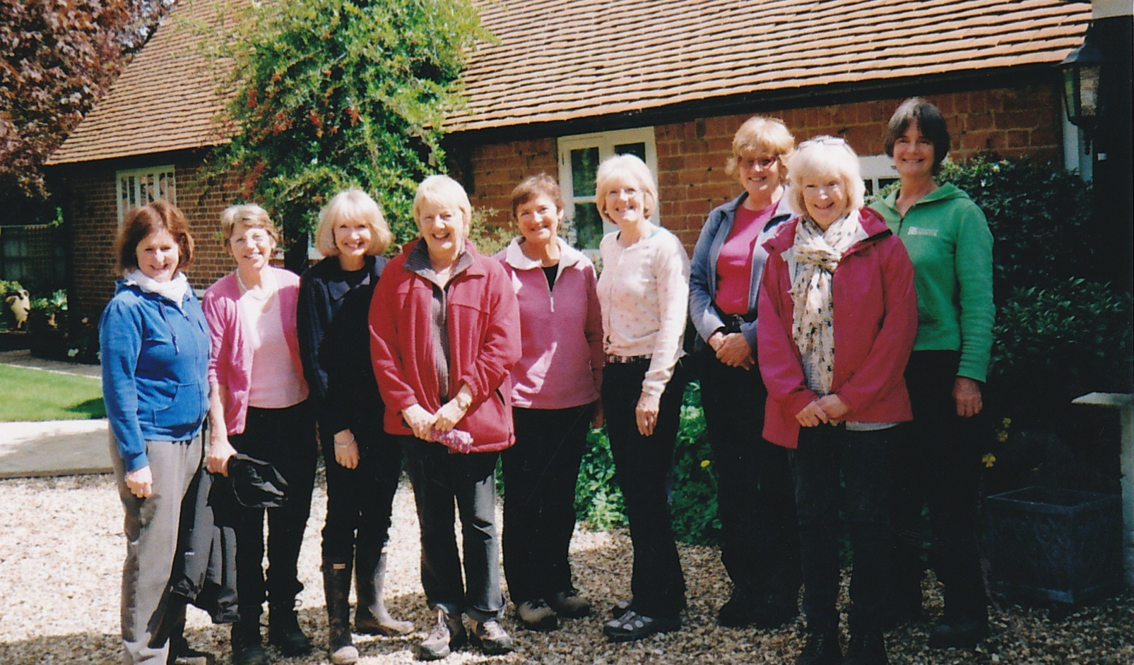
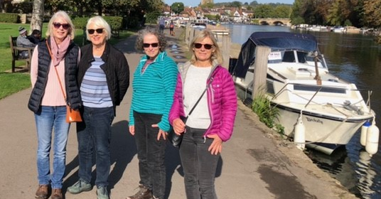
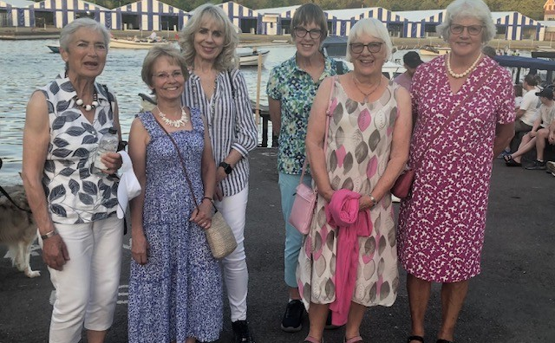
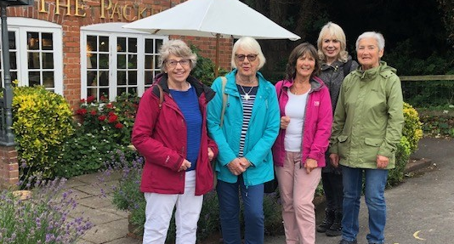
.
…and our pub walks!

Slide 17
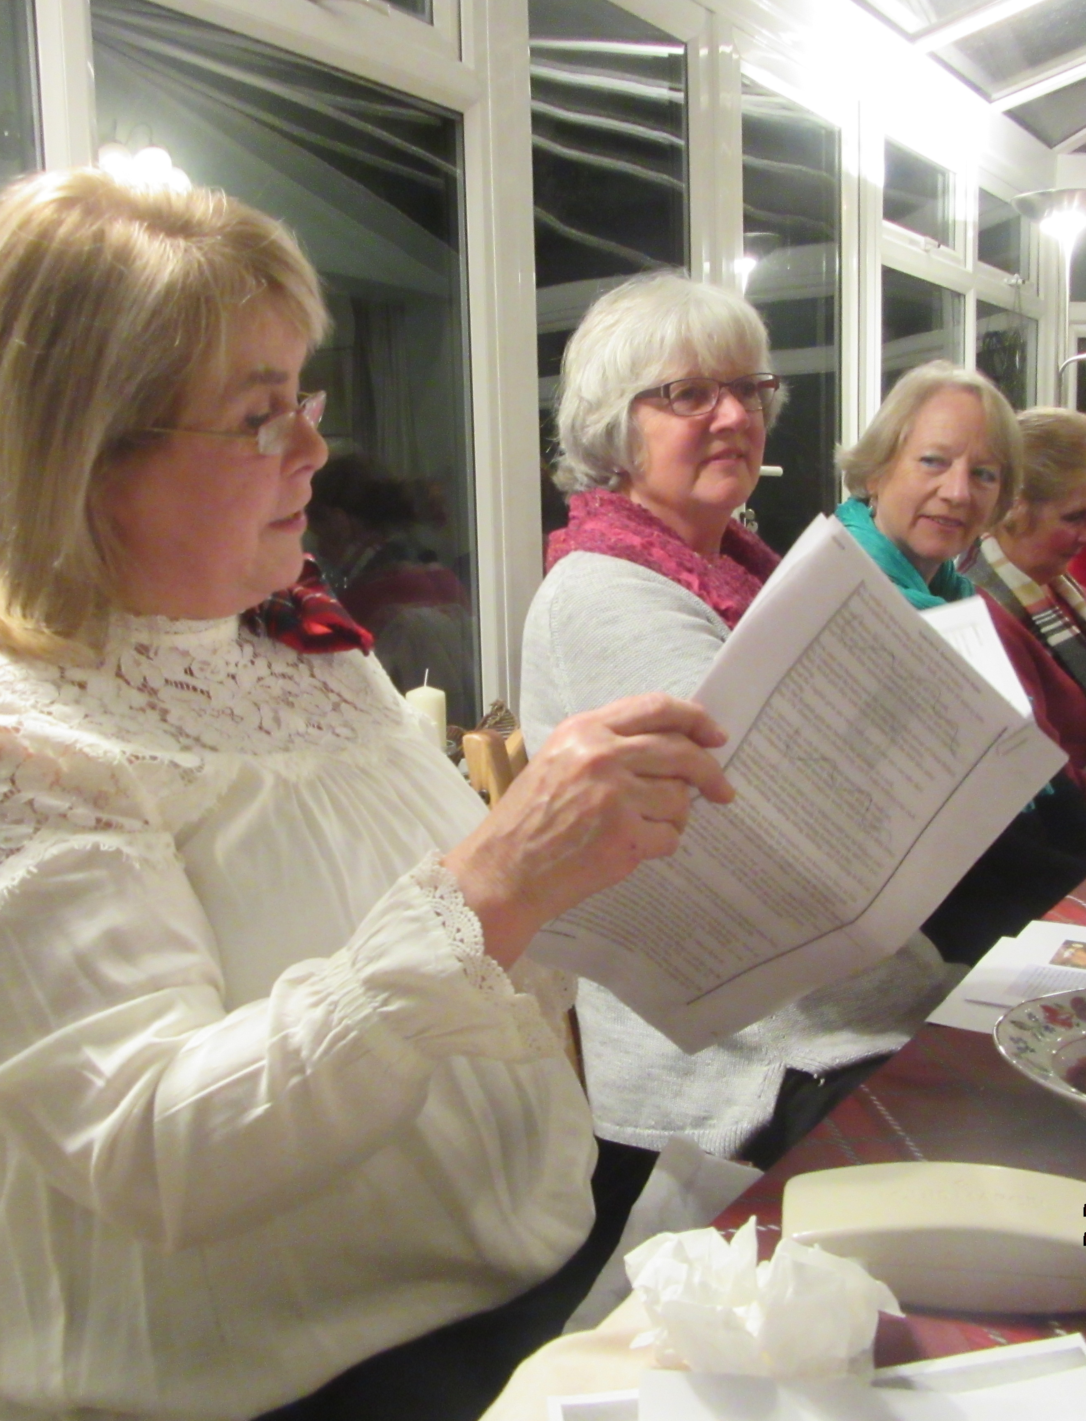
We always enjoy a good quiz!
The NWR Telephone Treasure Trail is our annual interactive quiz night.

Slide 18
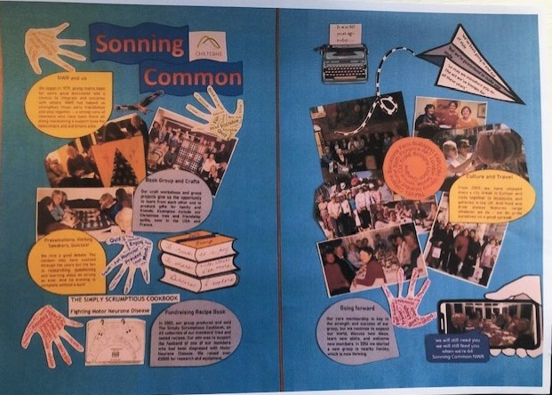
We contributed to the National Office Scrapbook Project and Archive

Slide 19
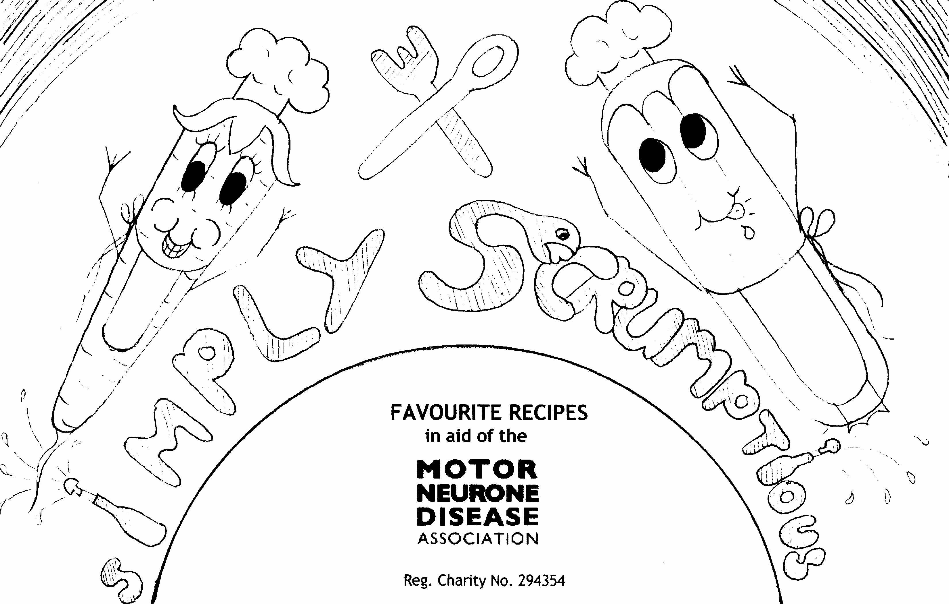
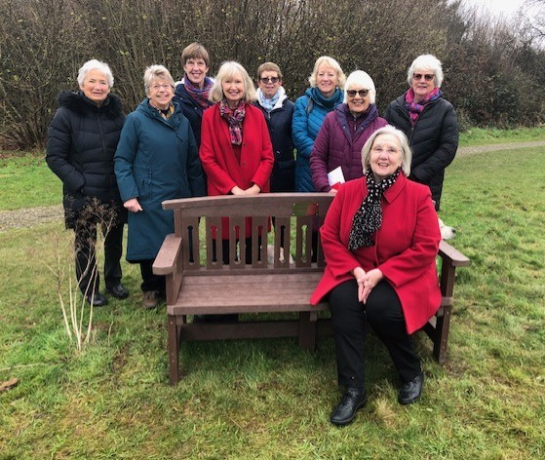
.
We worked together over the years to help and remember others.

Slide 20
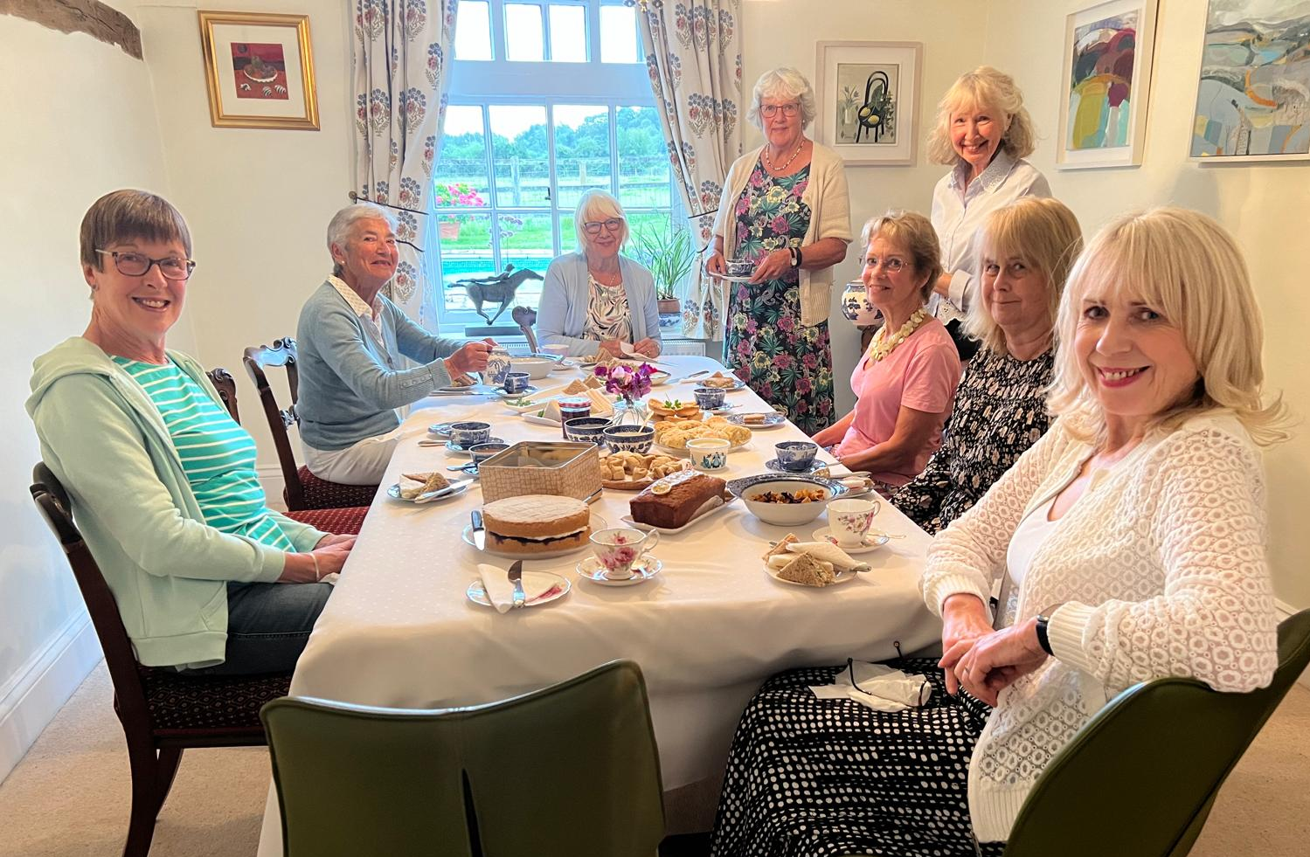
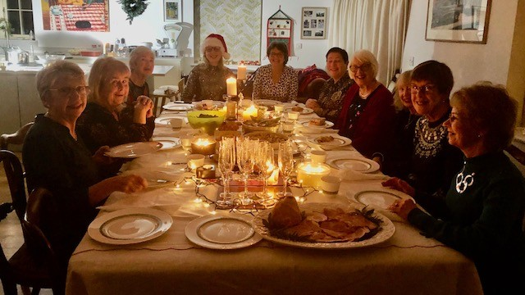
Most meetings consist of a meeting theme, either light hearted or more thought provoking…
…but there is always time for food and drink!

Slide 21
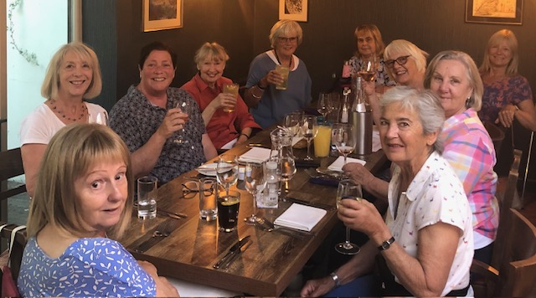
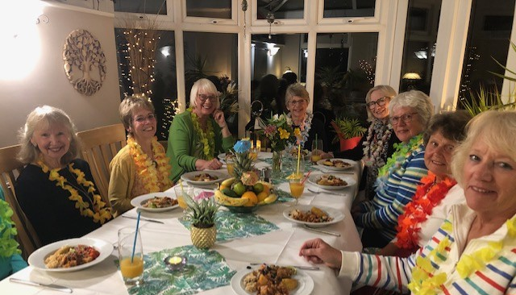
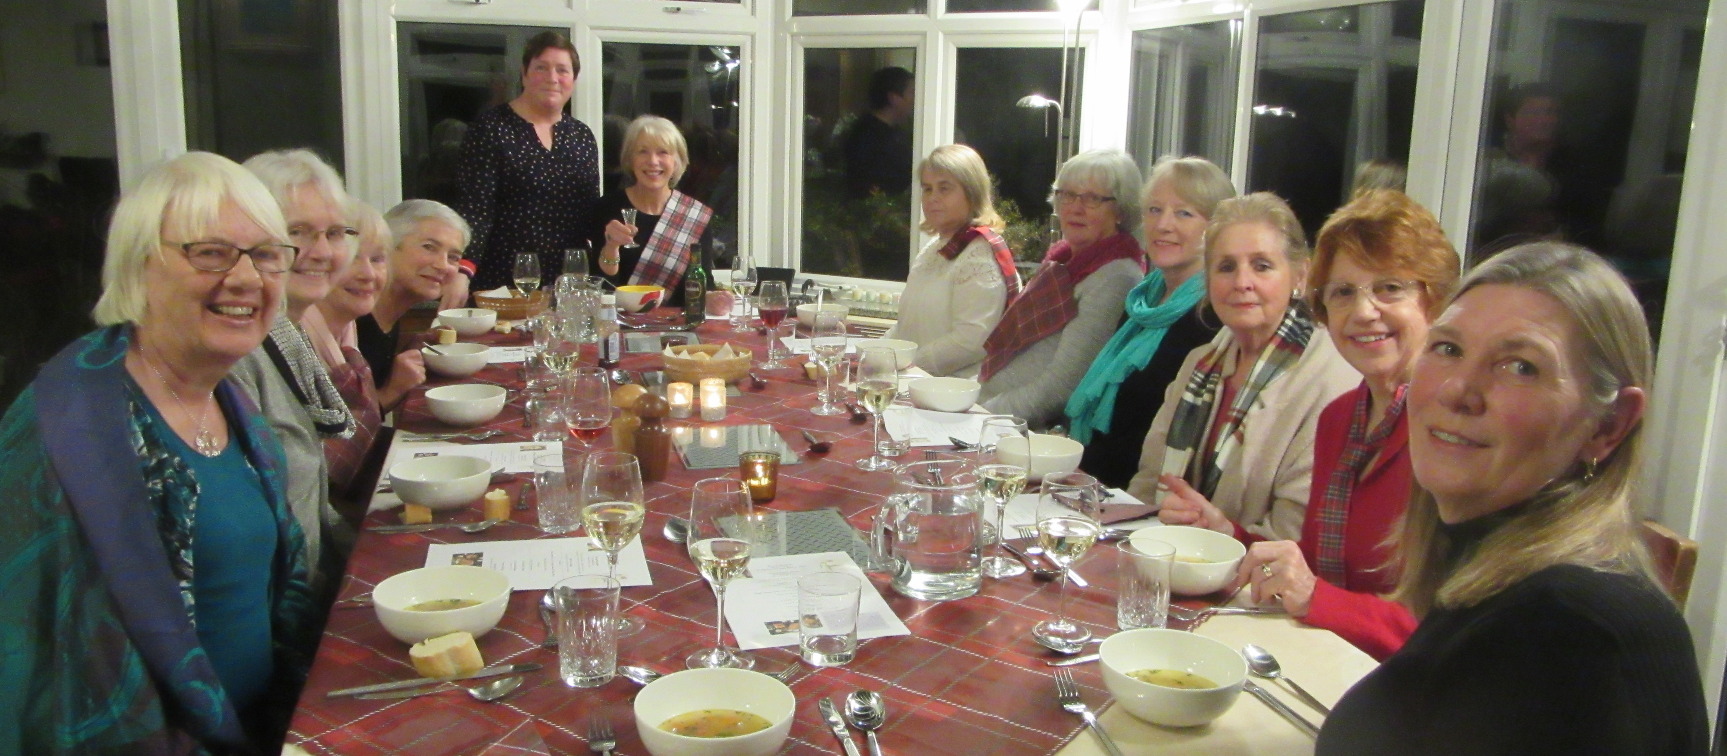
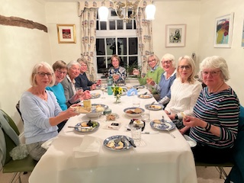
.
And more food and drink…..

Slide 22
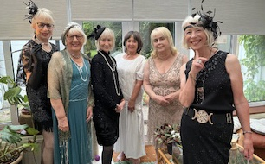
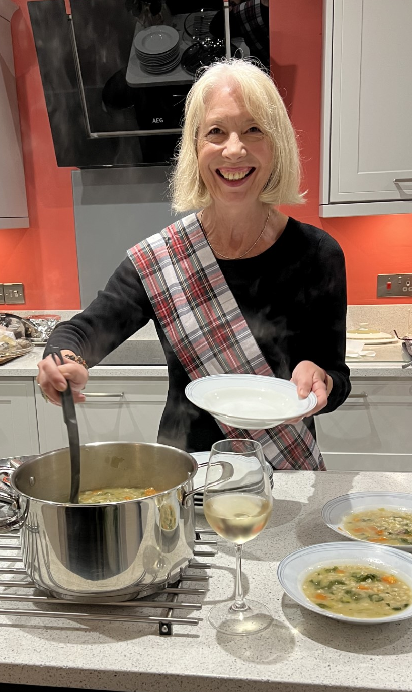
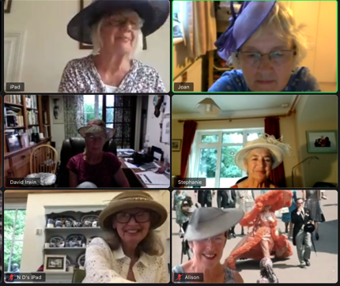

.
..and every chance to dress up of course!

Slide 23

Thank you to all our members for a wonderful 50 years!

Slide 24
We are
NWR Sonning Common -50 years and counting…
Please enjoy our 50th Celebration!

